Slide 1

The Hitchhiker’s Guide to
the Machine Learning
Engineering Galaxy
by Alyona Galyeva

Slide 2
Agenda
Introduction
AI-powered software vs traditional software
MLOps and AI-pipeline in a nutshell
ML Platform: What is this?
Hands-on with AI-pipelines:
Offline serving – batch
Online serving – near real-time

Slide 3
Introduction

Slide 4
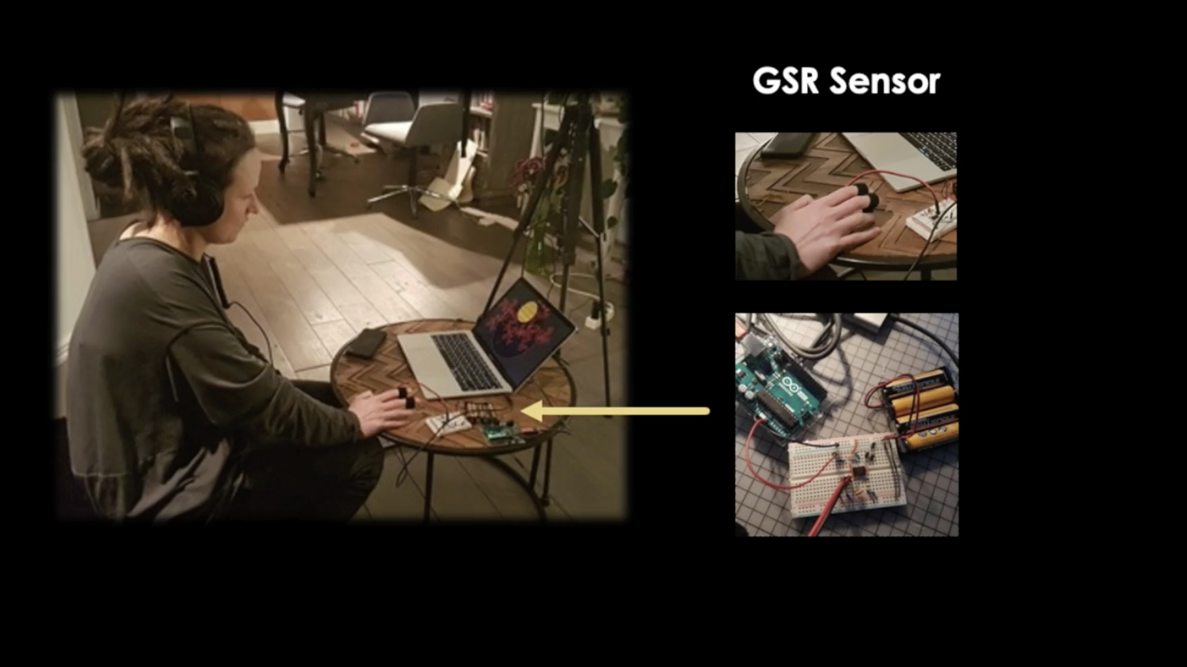
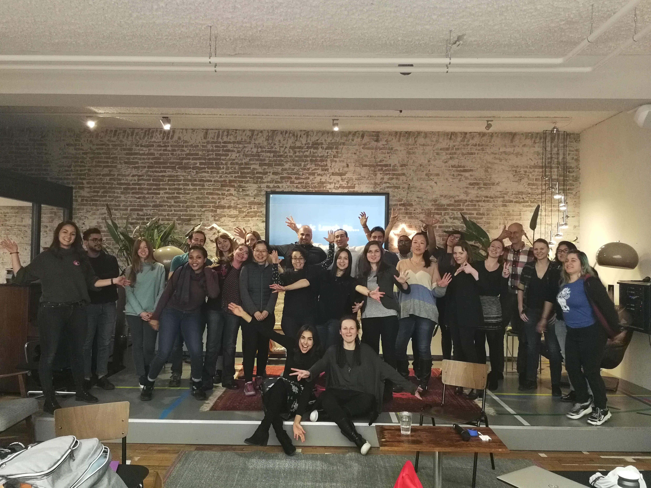



Slide 5
AI-powered software vs
traditional software

Slide 6
AI world
Regression
Sequences
Classification

Slide 7
Machine Learning vs Deep Learning
Data
Predictions
Data
Model
Model
Predictions
Features
Machine Learning
Deep Learning

Slide 8
AI vs traditional soft
Version
Code
Version
Code
Model
Data

Slide 9
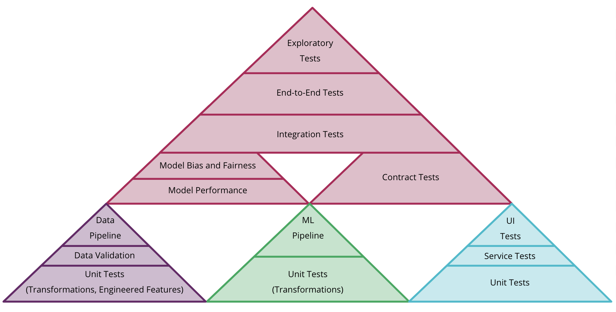
AI Tests
Source: https://martinfowler.com/articles/cd4ml.html

Slide 10
AI Monitoring
DevOps
Latency
ML related
Input drift
Ground truth
Business
Value
RAM usage
CPU usage
Benefits vs costs

Slide 11
MLOps and AI-pipeline in a nutshell

Slide 12
AI-pipeline
Pre-processing
Model
Post-processing

Slide 13
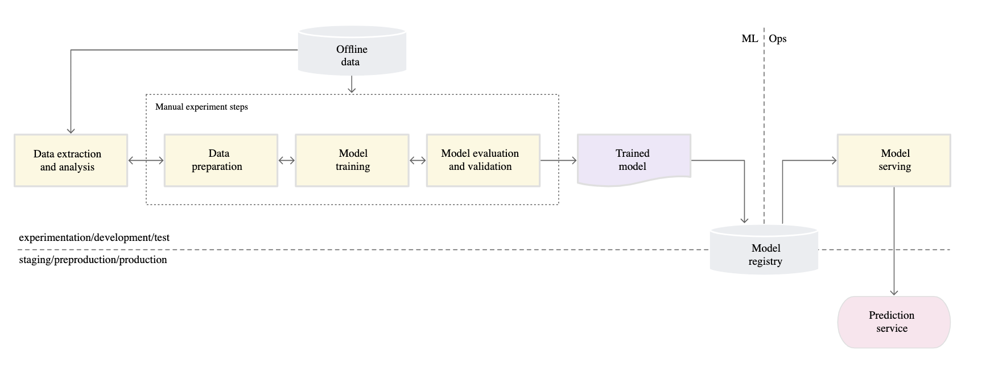
MLOps level 0: Manual process
Source: https://cloud.google.com/solutions/machine-learning/mlops-continuous-delivery-and-automation-pipelines-in-machine-learning

Slide 14
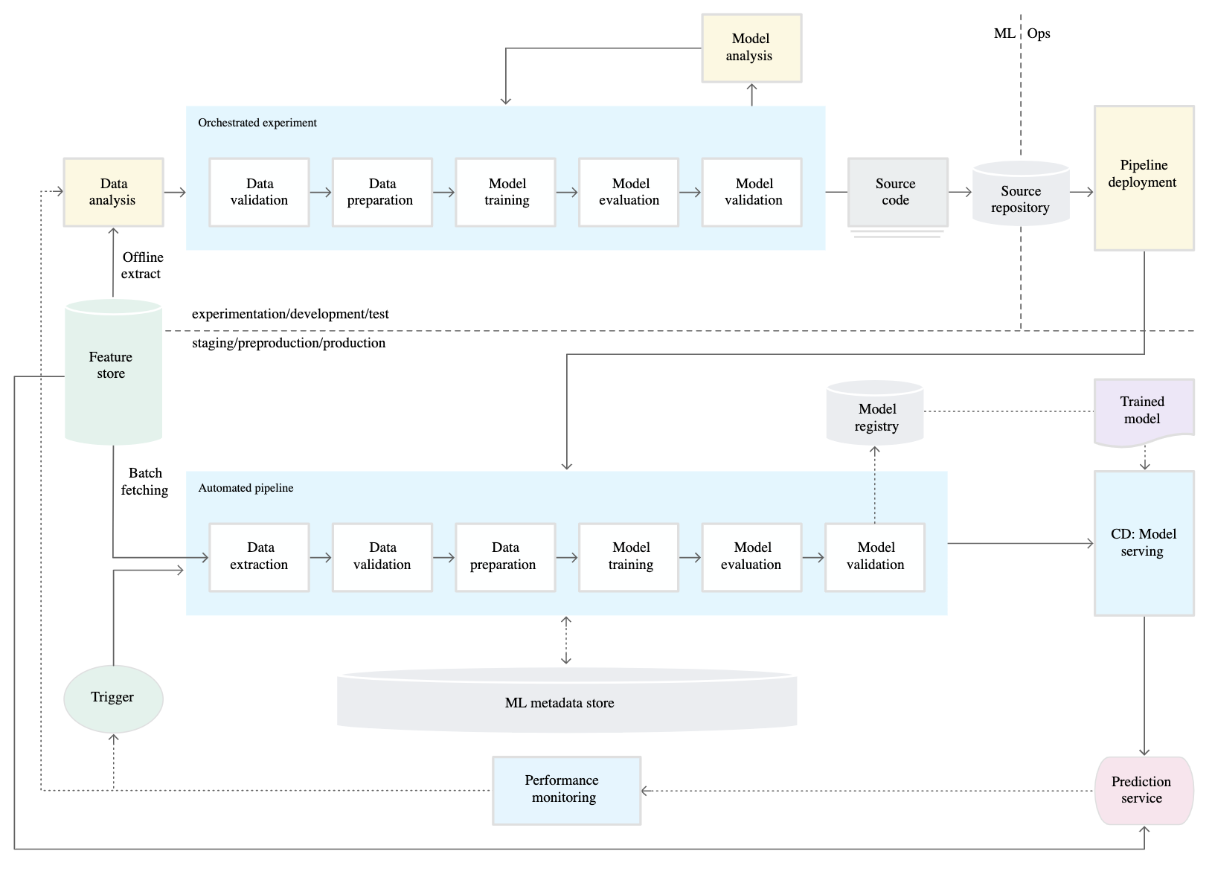
MLOps level 1: ML pipeline automation
Source: https://cloud.google.com/solutions/machine-learning/mlops-continuous-delivery-and-automation-pipelines-in-machine-learning

Slide 15
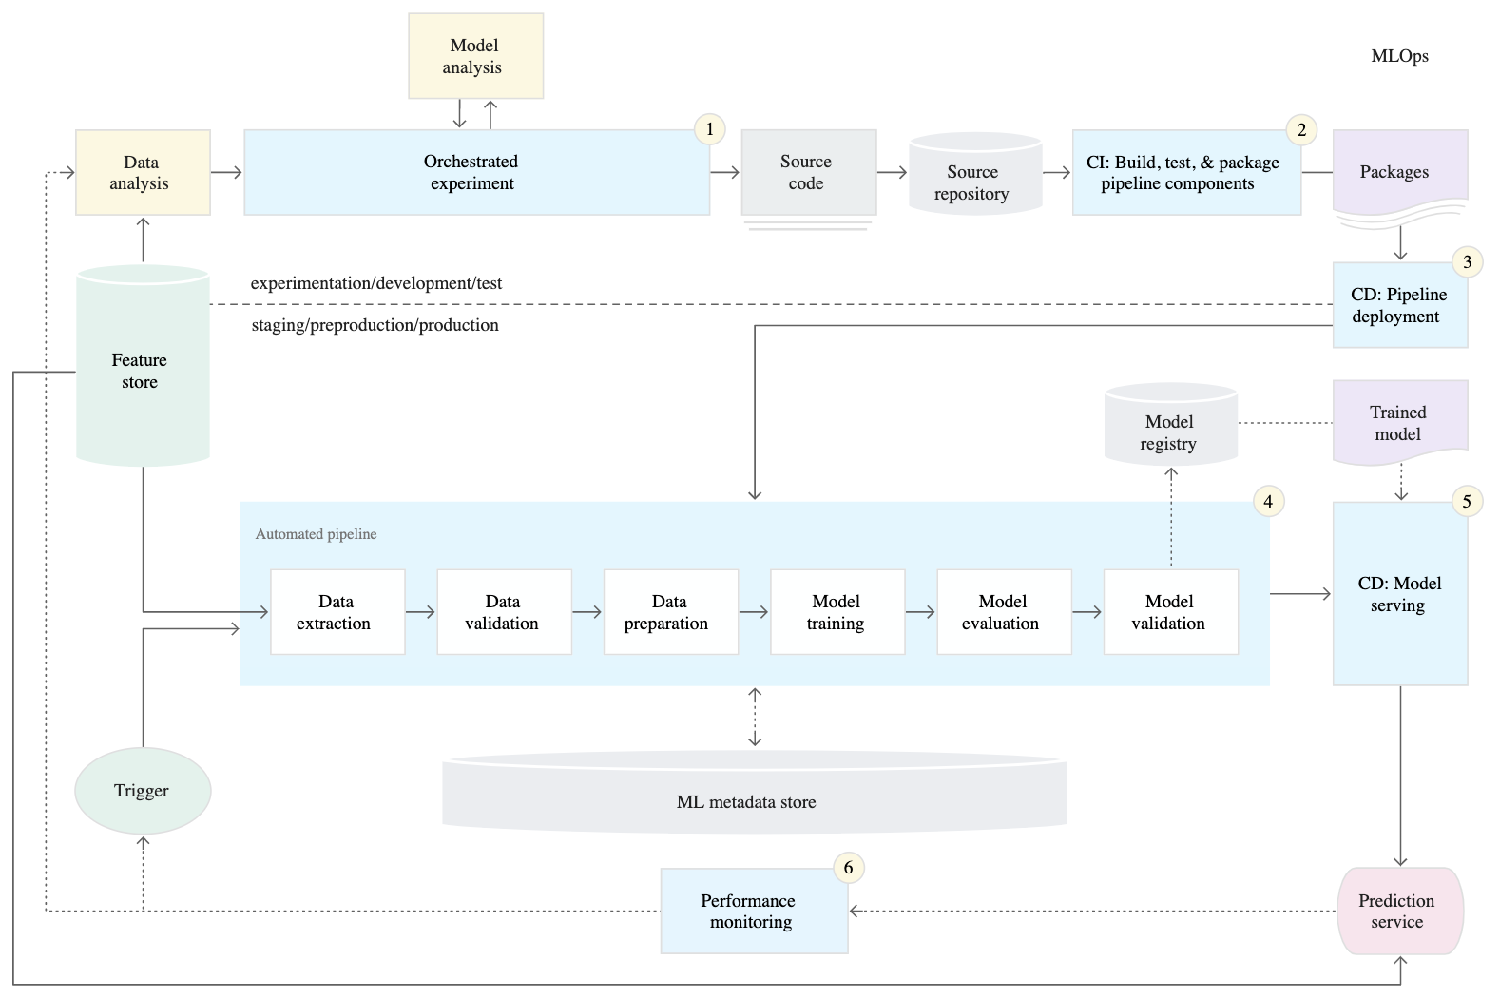
MLOps level 2: CI/CD pipeline automation
Source: https://cloud.google.com/solutions/machine-learning/mlops-continuous-delivery-and-automation-pipelines-in-machine-learning

Slide 16
ML Platform:
What is this?

Slide 17
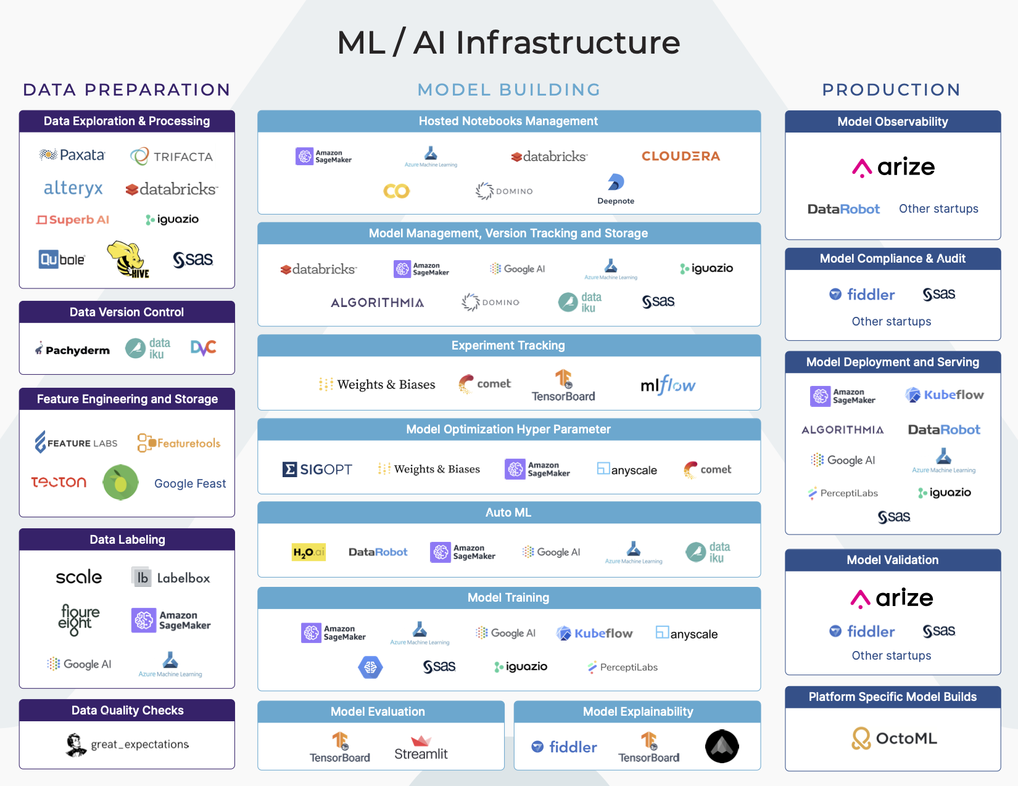
ML Platform: what is this?

Slide 18
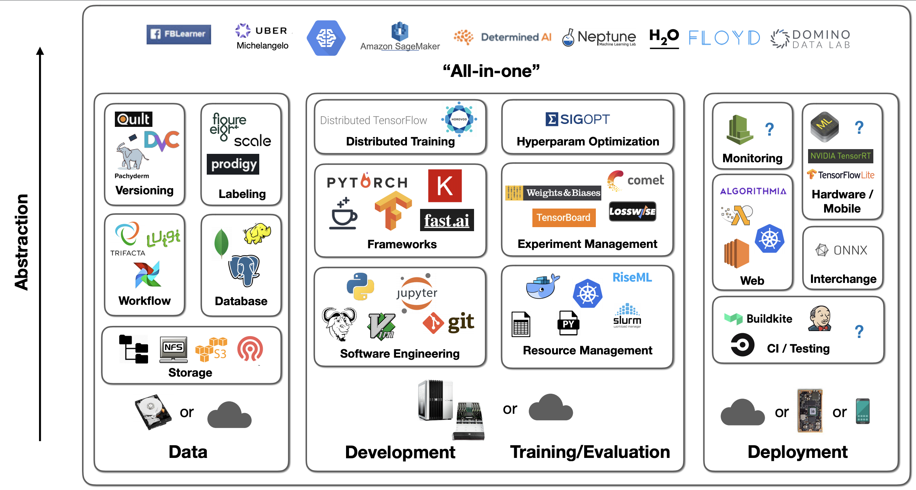
ML Platform: what is this?

Slide 19
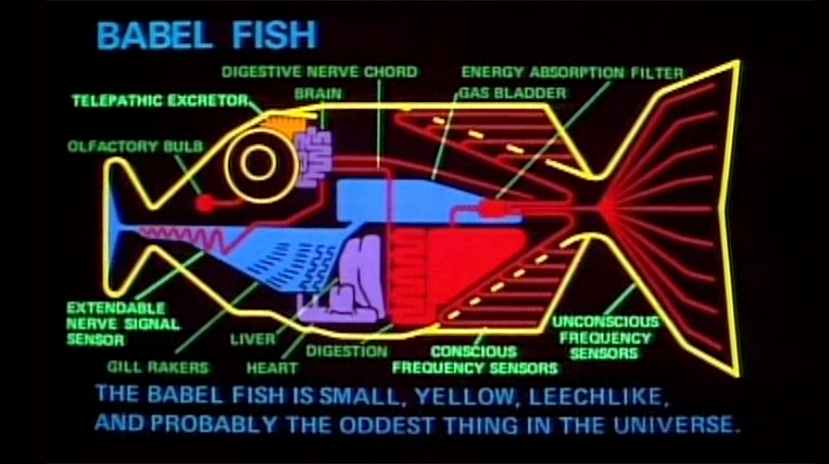

Slide 20


Slide 21
Hands-on with
AI-pipelines

Slide 22
https://github.com/EzheZhezhe/The-Hitchhiker-Guide-to-the-Machine-Learning-Engineering-Galaxy

